Slide 1








Lesson 1. Angular 4 nested components

Slide 2
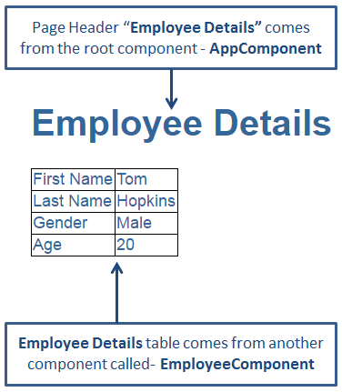
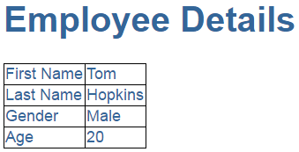
Angular 4 Nested Components

Slide 3
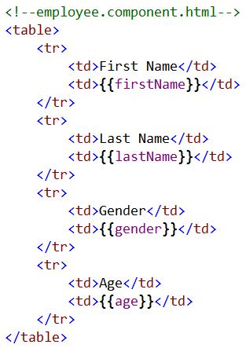
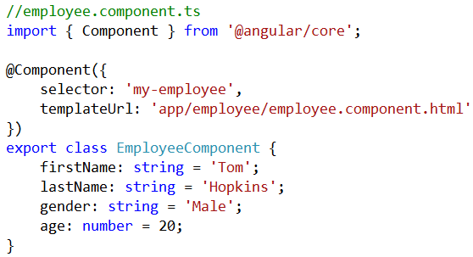
Angular 4 Nested Components

Slide 4
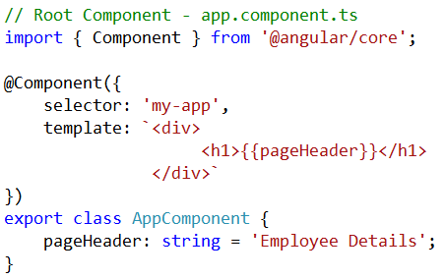
Angular 4 Nested Components
Since the View Template HTML is just 3 lines we have used an inline template instead of an external template
Please note : Angular4 recommends to extract templates into a separate file, if the view template is longer than 3 lines

Slide 5
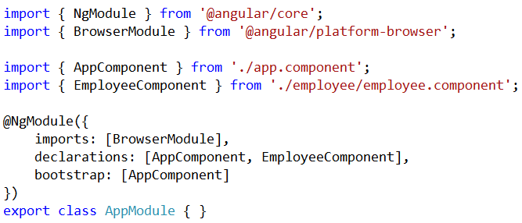
Angular 4 Nested Components
Nesting Angular Components
Step 1 : Import and add EmployeeComponent to declarations Array
What is AppModule
AppModule is the root module which bootstraps and launches the angular application
Import EmployeeComponent
Add EmployeeComponent to declarations array

Slide 6
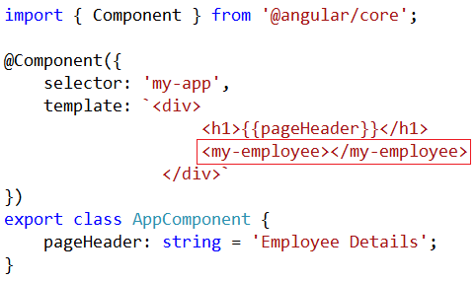
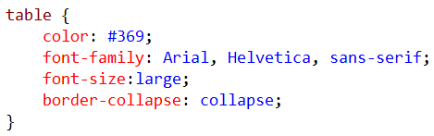

Angular 4 Nested Components
Step 2 : In "app.component.ts" file include "my-employee" as a directive
To style the table, include the following styles in styles.css file

Slide 7
Q & A
Contact:rashmipawaskar@synergetics-india.com

Slide 8
Thank You

